Slide 1
How to build a chatbot — Amara Graham (Keller) IBM Developer Advocate @MissAmaraKay
https://github.com/akeller/BCC-chatbot-talk
IBM Cloud: ibm.biz/BeerCityCode

Slide 3
Messaging Platform
Watson Assistant
Facebook Messenger
Slack
Chat portion
2. Parse Intents and Entities
3. Application decides if further action is needed
1. Capture user input
7. Return a response with dynamic data inserted into response.
3b/8. Return response back to user and wait for another user input to repeat process
6. Update context and send to Watson
Application
Third-party API
4. Make API call to get data or perform third-party action
NodeJS
Unity
Weather
5. Return dynamic data
Notes:
“Wrapper/wrapping application”
“Consuming application”

Slide 4
Guts of a chatbot
Intents
Entities
Dialog
Context

Slide 5
#Intents
An intent is the goal or purpose of the user’s input.
Notes:
An intent is a purpose or goal expressed in a customer's input, such as answering a question or processing a bill payment.

Slide 6
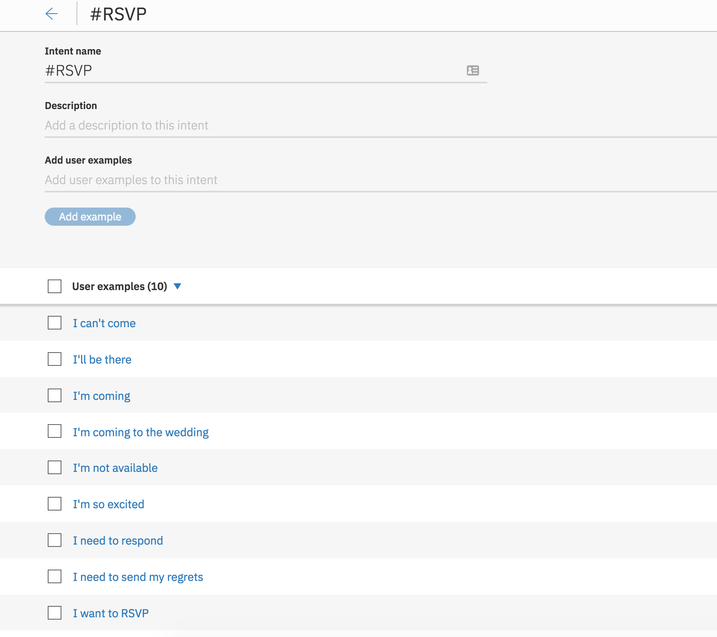
Provide at least five examples for each intent.

Slide 7
@Entities
An entity is a portion of the user’s input that you can use to provide a different response to a particular intent.
Notes:
An entity represents a class of object or a data type that is relevant to a user's purpose. By recognizing the entities that are mentioned in the user's input, the Conversation service can choose the specific actions to take to fulfill an intent.

Slide 8
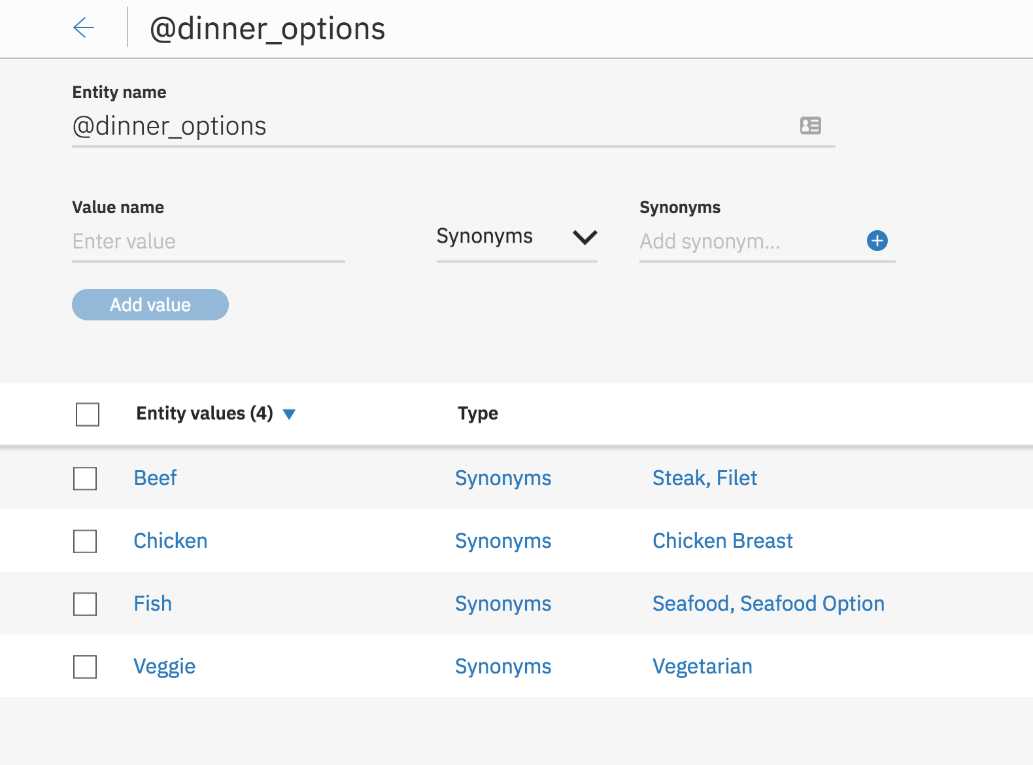
Can use synonyms or regex patterns.

Slide 9
Dialog
A dialog uses intents, entities, and context from your application to return a response to each user’s input.

Slide 10
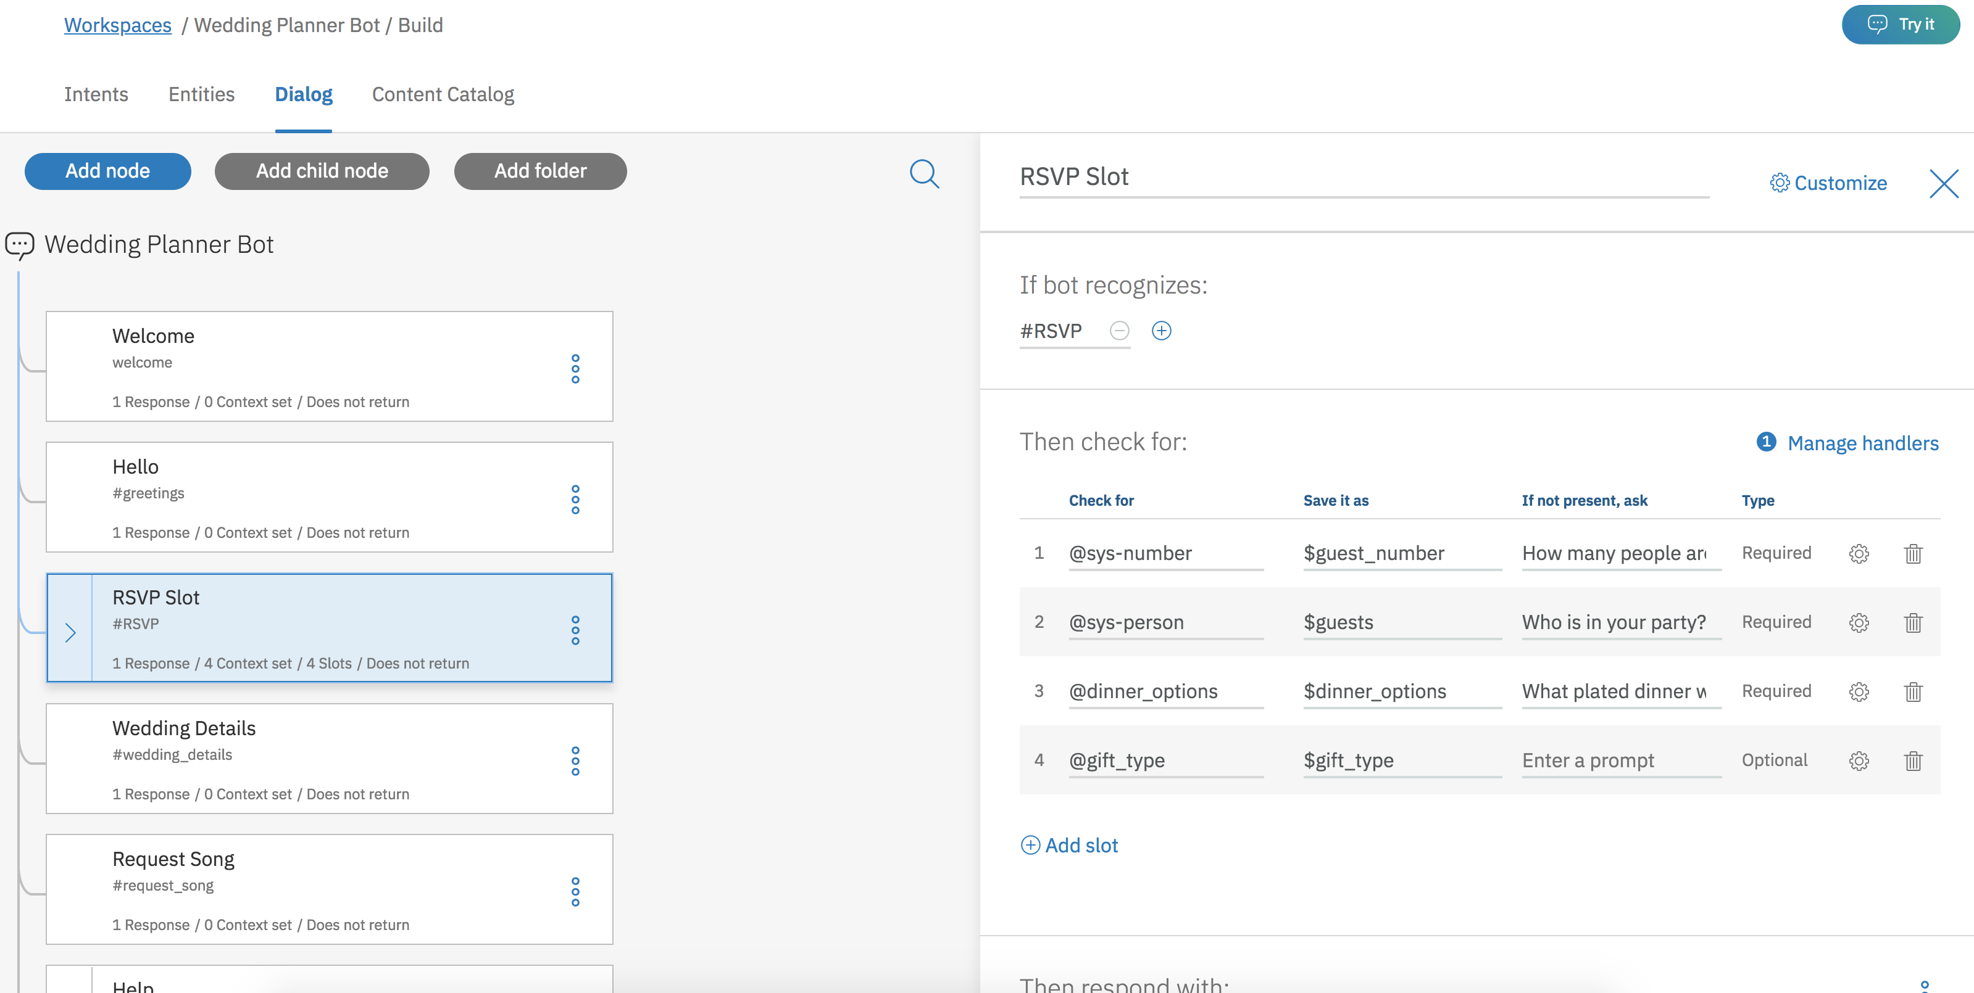

Slide 11
$context
Context keeps Watson aware of what has taken place in the conversation.
Notes:
Watson is inherently stupid without context. Watson is stateless.

Slide 12
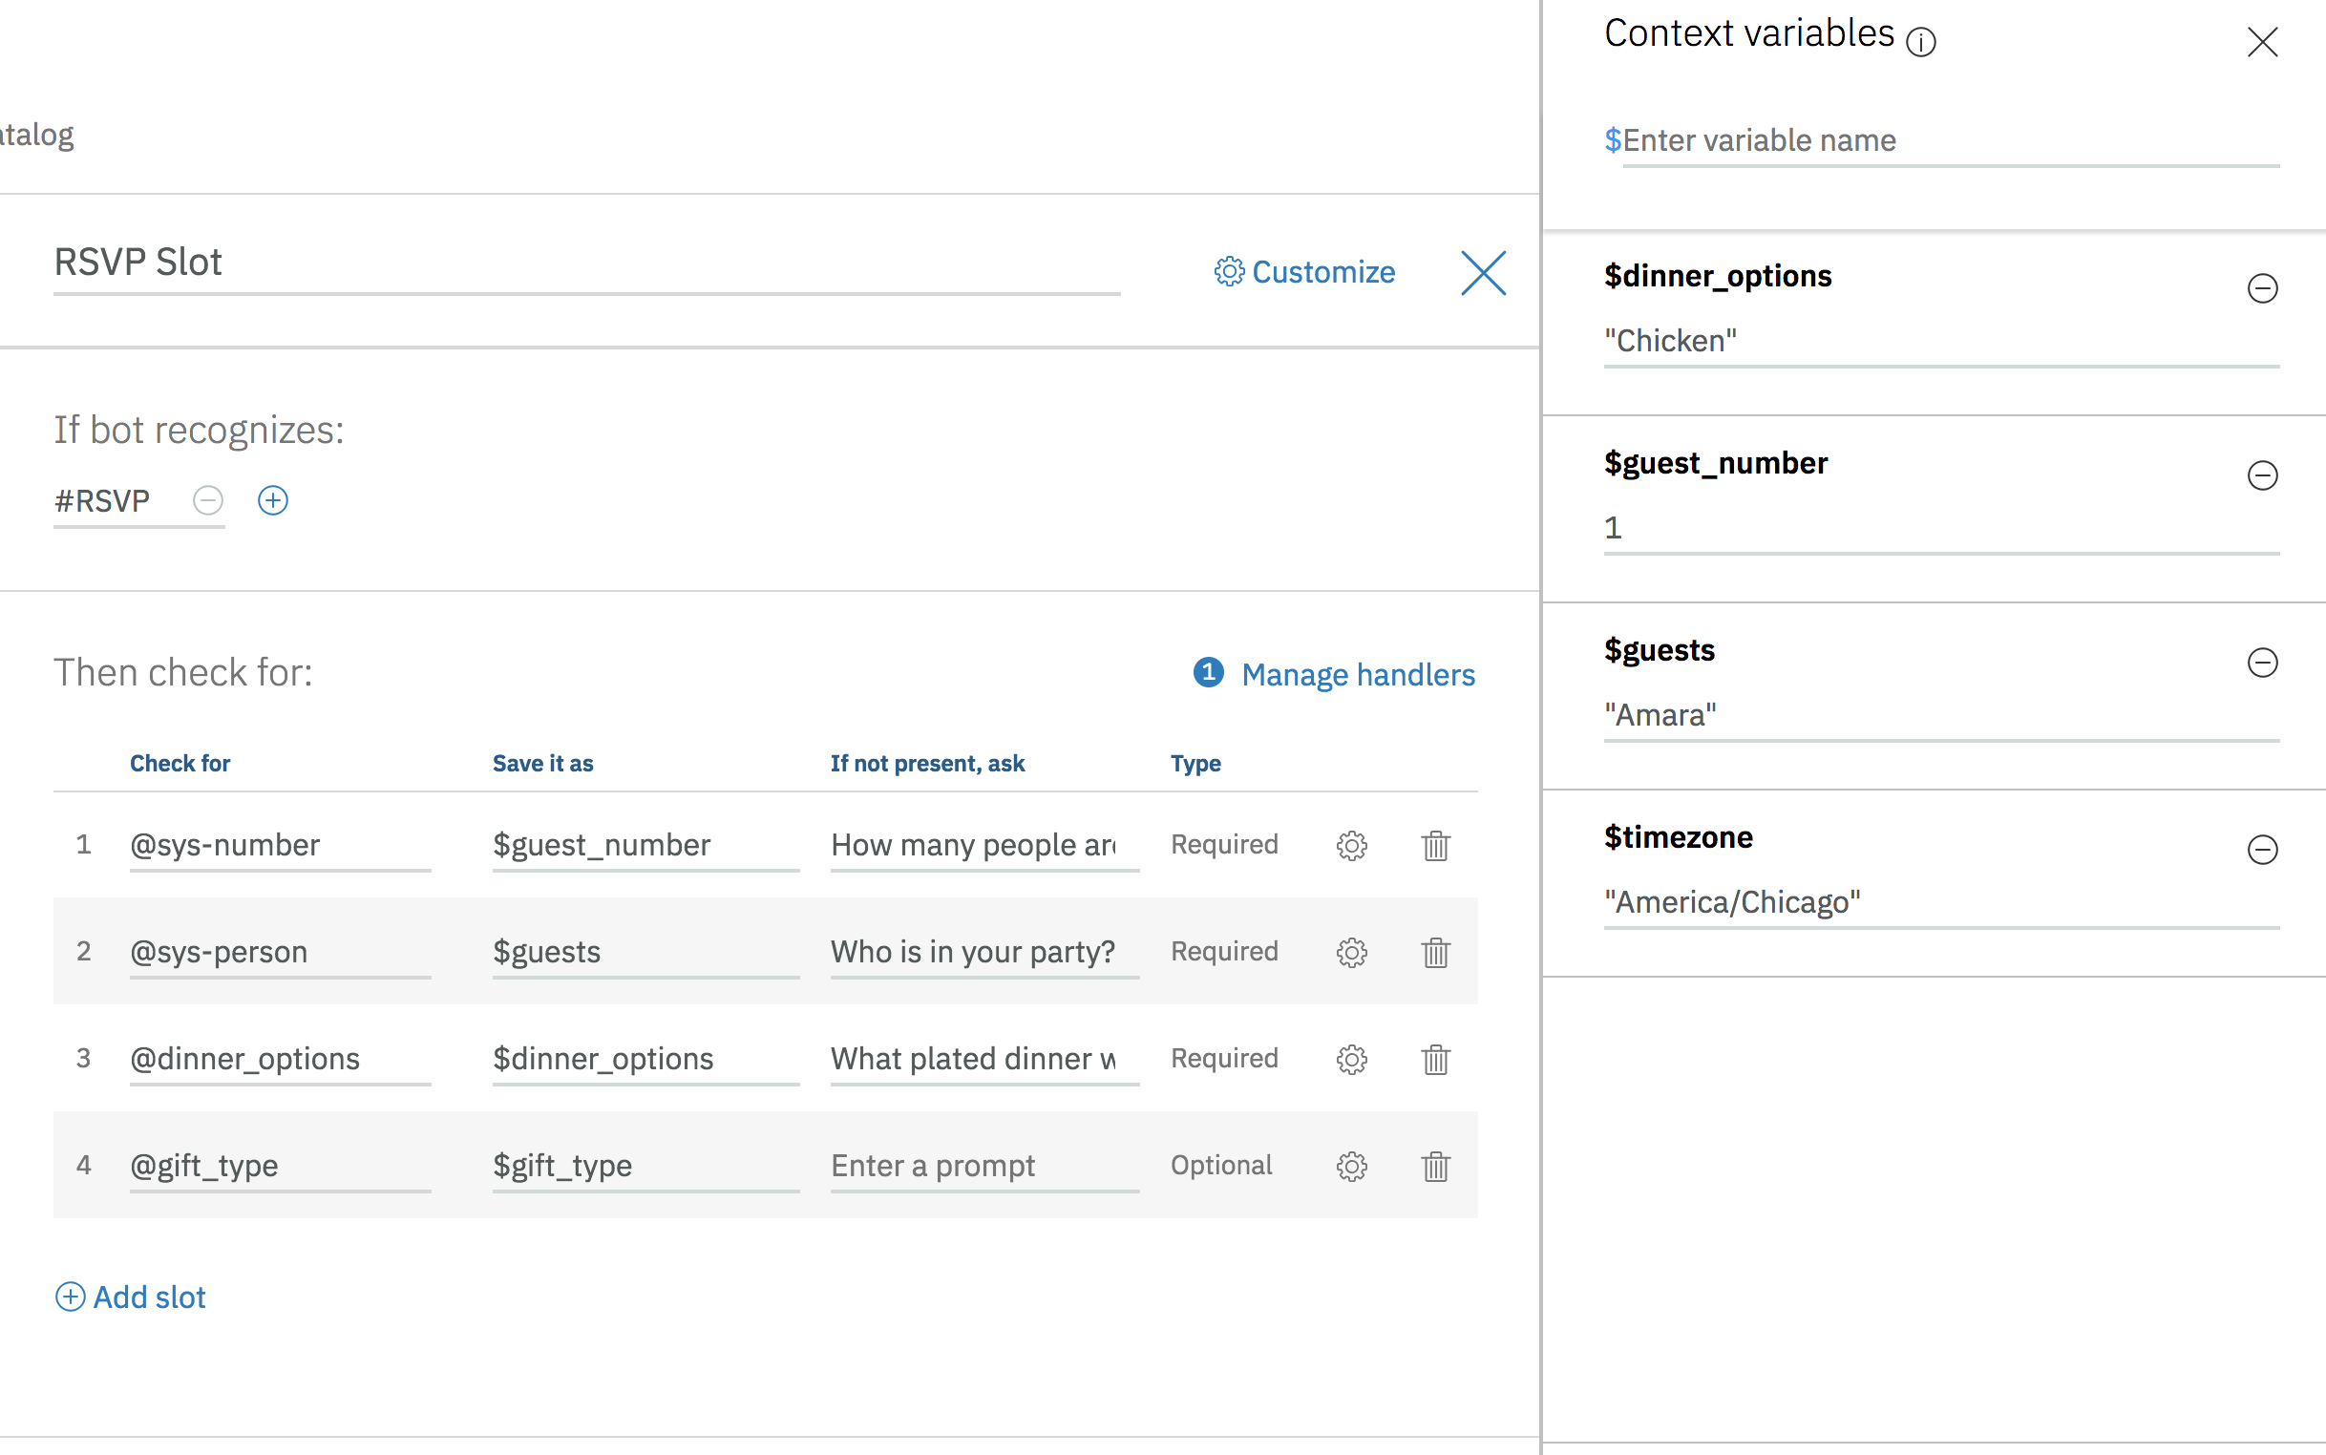

Slide 13
DEMO!

Slide 14
Additional Links
IBM Cloud: ibm.biz/BeerCityCode
Pizza Ordering Chatbot: ibm.biz/pizzachatbot
Cognitive Banking Chatbot: ibm.biz/bankingchatbot
https://github.com/akeller/BCC-chatbot-talk
https://developer.ibm.com/code/exchanges/bots/

Slide 15

Commit to the Cause
Get to know about “Call for Code”
http://developer.ibm.com/callforcode
Push For Change
Register for the IBM Coder
Answer the Call
Take the Angel Hack challenge to unlock the next steps
Notes:
If you a looking for additional resources, visit the IBM Code page for a variety of technical assets around the 6 key technical areas
Build resilient financial networks to execute secure transactions quickly
Translate voice and written communications on the fly to improve information sharing
Understand, analyze, and predict healthcare and nutrition needs to improve basic services
Improve logistics based on traffic and weather activity to reduce number of people affected
Analyze device sensor data to take corrective or preventative action automatically
Use visual recognition to process claims quickly or identify immediate need for aid
The Coder website is a great place to form a team, find code examples and join a community of thousands of developers

Slide 16
Thank you
Amara Graham (Keller)
Developer Advocate
—
amara.keller@ibm.com
@MissAmaraKay

